Slide 1
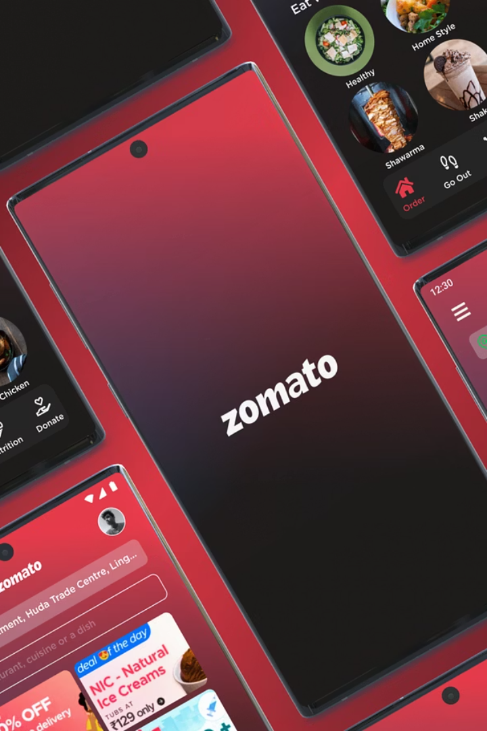
Zomato Restaurants Analysis: Multi-Dimensional Insights Dashboard
MSc Analytics Practicum – NTU
Singh Shivang
Notes:
Good evening. I’m shivang, and today I’ll walk you through my MSc Analytics practicum on Bengaluru’s restaurant landscape. We’ll cover how we transformed raw Zomato data into actionable insights through cleaning, exploratory and spatial analysis, sentiment mining, and interactive dashboards, demonstrating cohesive methodologies and real-world applications

Slide 2
Introduction to Bengaluru's Restaurant Ecosystem
Urban Food Data Complexity & Platform Choice
Stakeholder Needs:
Urban Planners: Need spatial density maps and quality gradients to inform infrastructure, zoning, and public policy decisions.
Zomato is India’s leading restaurant discovery, delivery, and reservation platform, aggregating user reviews, ratings, menu data, and pricing for over 12,000 Bengaluru outlets.
Restaurateurs & Investors: Require granular market intelligence on hot zones, underserved areas, and competitive benchmarks to guide openings and expansions.
Extensive coverage and rich metadata make it an ideal dataset to study urban dining patterns and consumer sentiment.
Consumers & Food Enthusiasts: Seek reliable, personalized recommendations that account for true customer satisfaction beyond raw star ratings.
Data heterogeneity—from numeric ratings to unstructured review text—requires scalable, automated pipelines for cleaning and analysis.

Slide 3

Objectives
Data cleaning & Feature Engineering
Interactive recommendation dashboard
Review sentiment quantification
1
2
3
4
5
Exploratory & geospatial insights
Composite performance metrics
Notes:
Data cleaning & Feature Engineering Implement end-to-end cleaning and imputation for trustworthy analysis. Exploratory & geospatial insights Uncover patterns through statistical summaries, visualizations, and geospatial mappings. Review sentiment quantification Mine and quantify textual feedback to enhance rating insights. Composite performance metrics Develop a composite score blending quantitative ratings, sentiment, and engagement volume. Interactive recommendation dashboard Deliver dynamic dashboard to help consumers find restaurants that match their preferences.

Slide 4


Dataset Overview & Initial Challenges
Data Source: Zomato Restaurants Dataset Kaggle (March 2019 snapshot). Scope: 51,696 records × 17 attributes (ratings, votes, cost, cuisines, reviews, location, rest. types).
Initial Data Challenges:
Parsing Textual Values: Ratings in “X.X/5” format and reviews stored as strings.
Missing & Inconsistent Data: Approximately 10% missing ratings, null cost entries, and blank categorical fields.
Multi‑Valued Fields: Comma‑separated cuisines and service types required normalization.
Unstructured Text: Reviews needed parsing and cleaning before NLP.

Slide 5
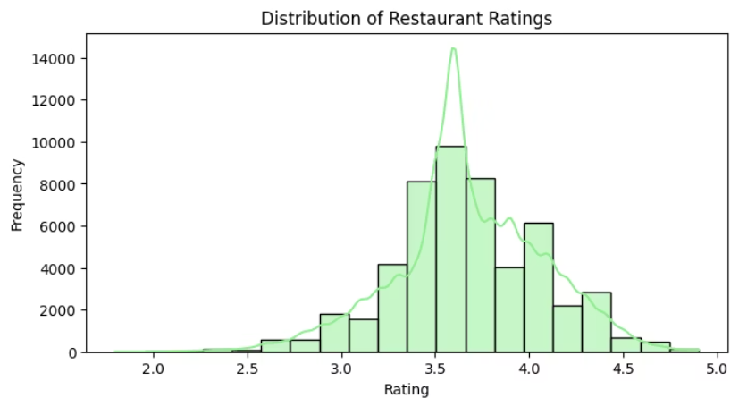
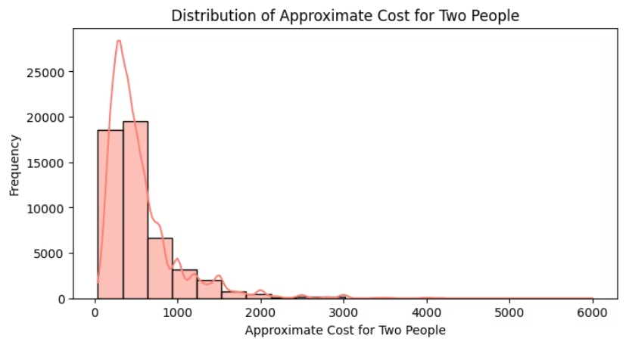
Data Cleaning
Major processes apart from standard power query data cleaning
Ratings Imputation
Cost Field
Trained a linear regression model using votes and approx_cost as predictors, effectively imputed ratings based on observed relationships.
Null values in approx_cost(for two people) were substituted with the column mean, preventing bias in subsequent cost analyses.
Categorical Imputation
For rest_type, dish_liked, and cuisines, missing values were filled with the column’s statistical mode to maintain categorical integrity

Slide 6
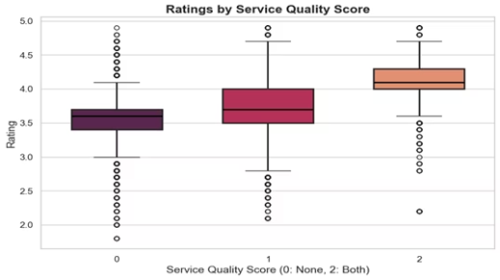
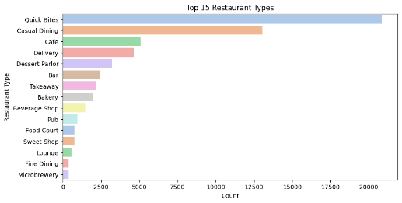
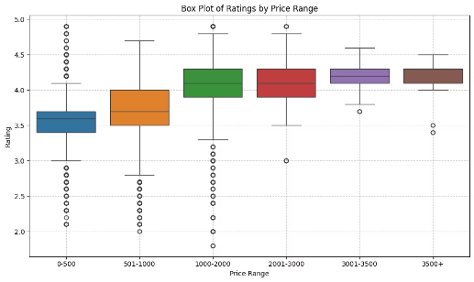
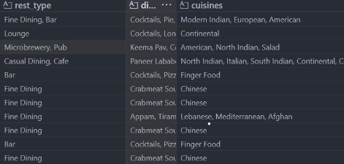
Feature Engineering
Service Score
Dimension Tables
Geocoding
Binary encodings of online_order and book_table were summed into a composite service_score, reflecting overall service capability.
Multi-valued fields were exploded into separate dimension tables (CuisineDim and ServiceTypeDim) linked by restaurant name. This normalization facilitated flexible slicing in dashboards.
Restaurant addresses were geocoded via the Google Maps API, producing latitude and longitude coordinates that enabled spatial analysis.
Price Range Bucketing
We segmented approx_cost(for two people) into six discrete bins (e.g., 0–500, 501–1000 up to 3500+), stored in a new price_range column.

Slide 7
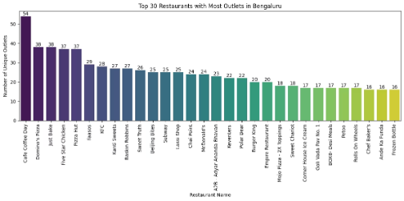
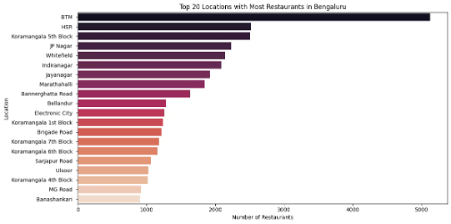
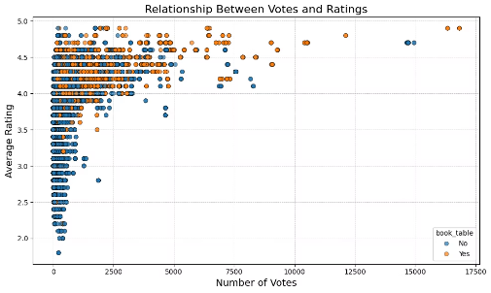
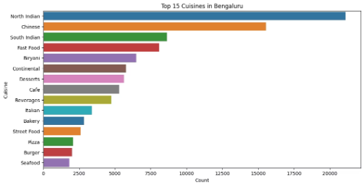
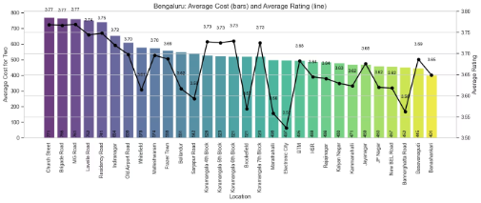
Exploratory Data Analysis (EDA) Highlights
Popular Restaurants & Cuisine
Market Concentration
Votes vs Ratings
North Indian cuisine leads with over 20,000 listings, followed by Chinese and South Indian.
BTM and HSR Layout are dining hubs with most outlets. Central city offering more premium experience.
High-vote restaurants tend to have ratings above 4.0 stars; table-booking availability correlates with popularity and satisfaction.

Slide 8
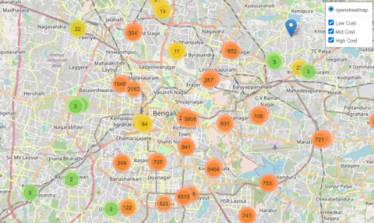
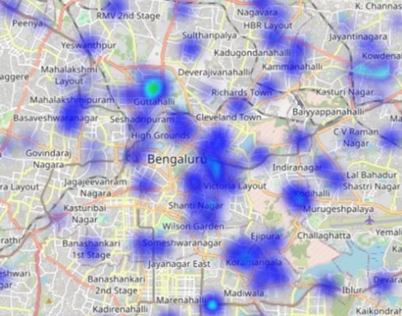
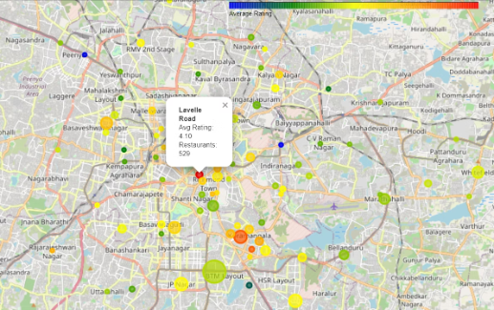
Geospatial Visualization of Bengaluru Restaurants
Heatmaps
Marker Clusters
Neighbourhood Aggregation
Show overall and tiered restaurant density, highlighting central & southern Bengaluru's restaurant concentration.
Markers coloured by the number of restaurants showcase budget and premium corridors.
Bubble maps reveal outlet counts and average ratings, with BTM showing high density and Lavelle Road high ratings.
Cuisine Insights
Color-coded markers identify top-rated cuisines by location, guiding users to preferred dining options.

Slide 9








Sentiment Analysis and Review Scoring
Review Parsing & Text Cleaning
Data Format: reviews_list column contains stringified tuples like ('Rated 4.0', 'RATED Review text…').
Safe Parsing: Converted strings to actual lists using ast.literal_eval for 100K+ entries.
Regex Cleanup: Removed URLs, punctuation, non-alphanumeric characters etc.
Unicode Fixes: Applied ftfy to correct garbled characters.
Notes:
On Slide 8, we address the unstructured nature of customer reviews. Each record includes a stringified list of tuples, so we used ast.literal_eval for safe parsing, corrected encoding with ftfy, and cleaned the text via regex and stopword removal, preparing the corpus for sentiment analysis."

Slide 10
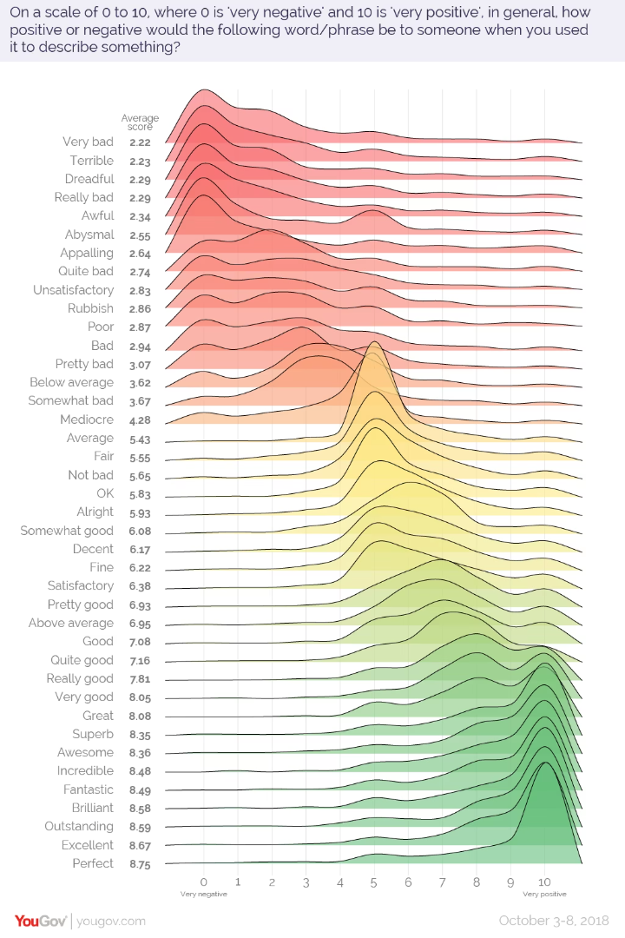




Sentiment & Composite Scoring
Sentiment Scoring
Aggregation
Computed TextBlob polarity (−1 to +1) and extracted numeric ratings from each review.
Grouped by restaurant to get average sentiment, average extracted rating, and review count.
Composite Score
Voila! our own restaurant rating!
Raw score = mean(extracted rating, sentiment)
Finally, we compute avg_review_score = raw_score * weighted_factor.
weighted_factor = 1 + ln(1+votes)/5
then min–max normalized to 0–5
Notes:
Slide 9 consolidates our sentiment pipeline and composite metric. After parsing reviews and cleaning text, we calculated sentiment polarity and extracted ratings per review. These were averaged per restaurant and combined with vote-based weighting into a single composite score, then scaled to match the 0–5 star format, capturing both textual nuance and engagement volume."

Slide 11
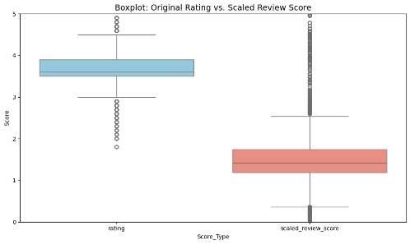
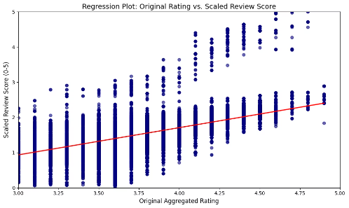
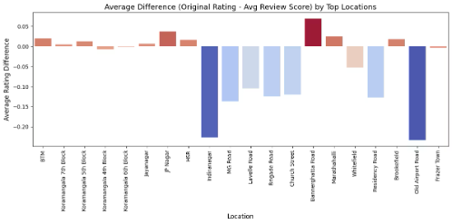
Star ratings VS Derived Review Scores - The Truth
Median comparison
Hint of Correlation
The Difference
Sentiment analysis surfaces more positive impressions in central areas than the raw star averages suggest.
The median of the scaled review score sits lower (around 1.5) than the median star rating (~3.8).
Upward slope, confirms that higher star ratings generally align with higher composite scores.
Notes:
Sentiment-weighted scores being more conservative, penalizes establishments with sparse or mixed reviews. Regression Scatter Details: Moderate Correlation (r ≈ 0.6): The red trendline slopes upward, confirming that higher star ratings generally align with higher composite scores. Vertical Spread: At each star rating level (e.g., 4.0), composite scores vary significantly (±1.0), surfacing restaurants where text sentiment diverges from the star label. Hidden Gems & Outliers: Points above the line represent venues whose positive reviews exceed their star ratings, while points below indicate potentially over‑rated restaurants with mixed or negative feedback. This chart shows how star ratings and our sentiment‑weighted “review score” differ by neighbourhood: Positive bars (e.g. Bannerghatta Road, BTM, JP Nagar) mean the original star rating exceeds the review score—suggesting a slight inflation of stars relative to textual feedback. Negative bars (e.g. Indiranagar, Old Airport Road, MG Road) mean the review score outpaces the star rating—indicating these areas may have hidden gems that customers praise in reviews more than their stars imply.

Slide 12

Power BI Dashboard Recommendation Engine
Let's finally dive into the power BI dashboard which acts like a recommendation engine for any potential customer who's in search of a suitable restaurant.

Slide 13
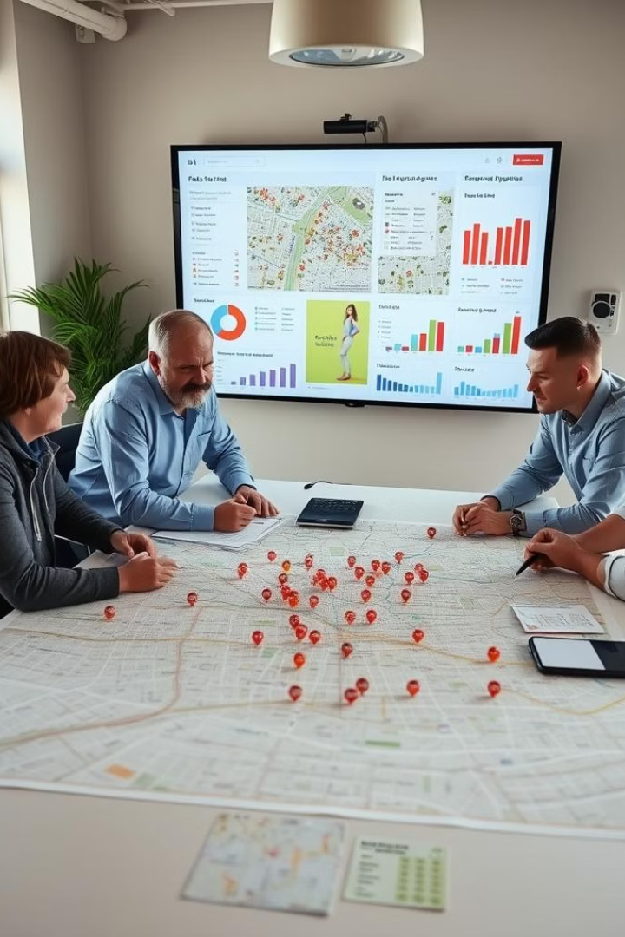
Key Findings and Recommendations
Urban Policy Makers
1
Use geospatial maps to improve infrastructure and support micro-enterprises in emerging food corridors.
Customers & Investors
2
Focus on mid-density suburbs with positive sentiment but fewer high-quality options; benchmark using weighted review scores.
Platform Developers
Enhance sentiment models, integrate real-time data, and explore hybrid recommendation methods combining content and collaborative filtering.
3

Slide 14
THANKS FOR YOUR TIME!

